Slide 1
2013_09_09
Start building vectors for more promoter probe testing

Slide 2
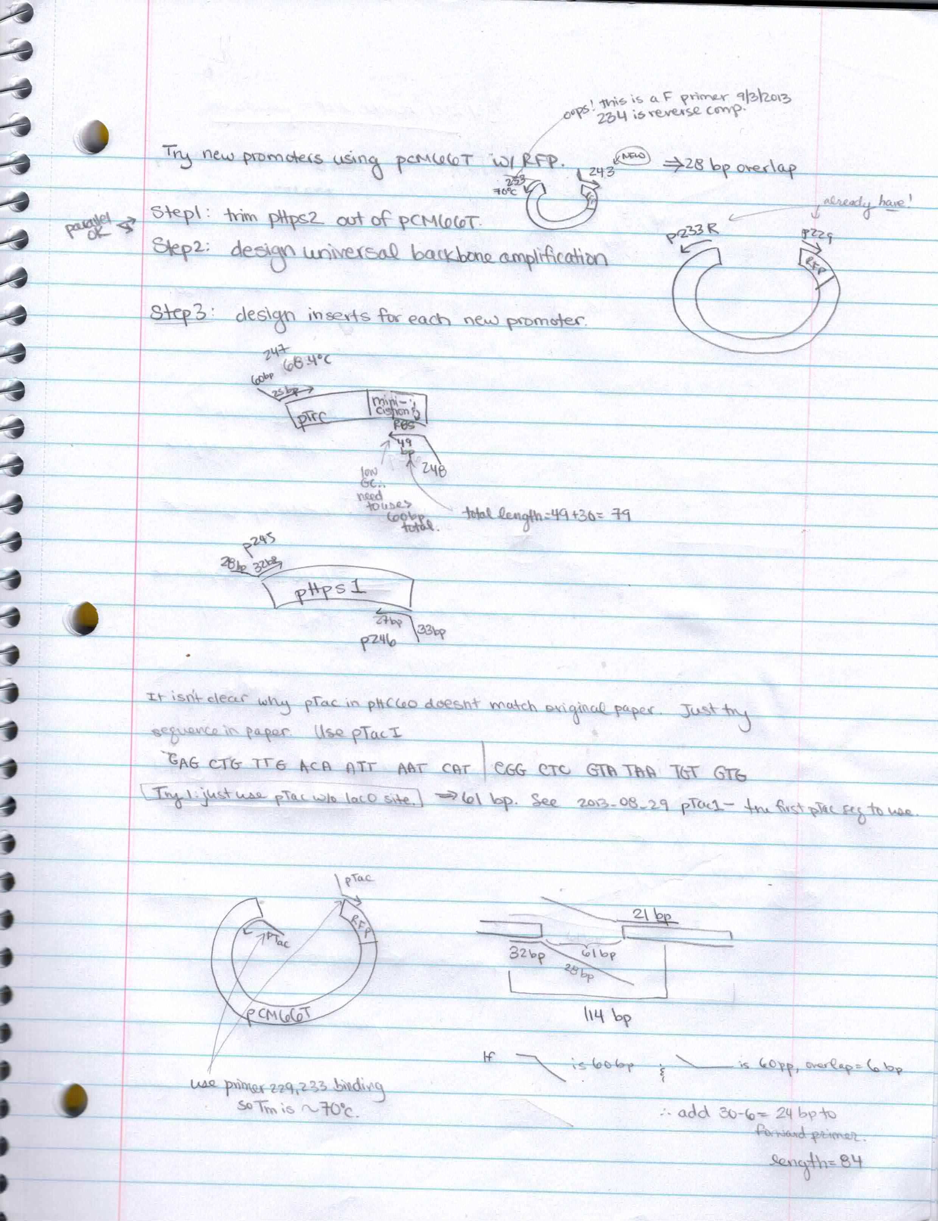

Slide 3
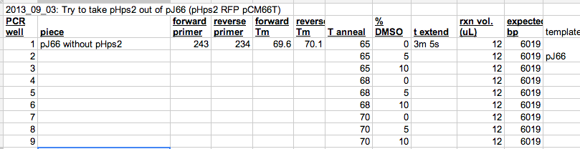
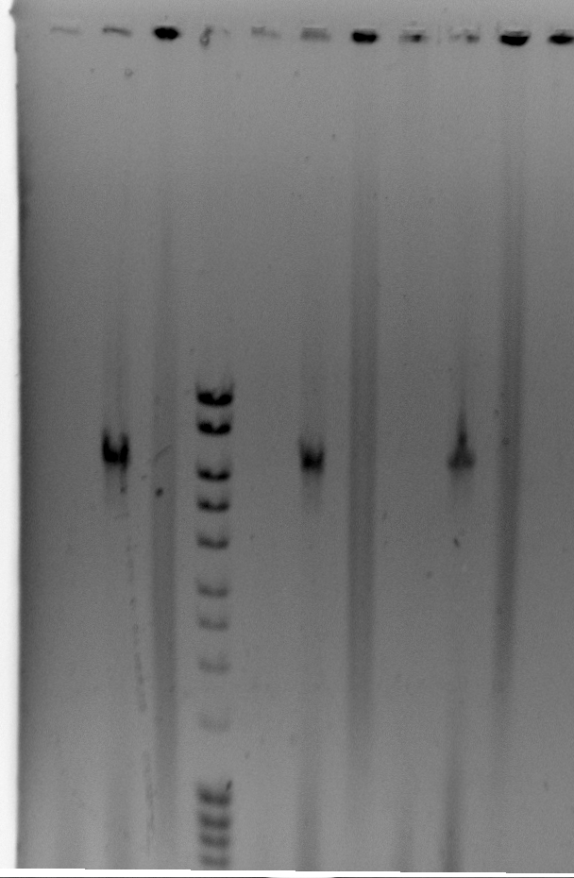
2013_09_03 remove pHps2 from pJ66 (pHps2 RFP pCM66T)

Slide 4
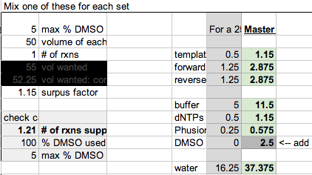
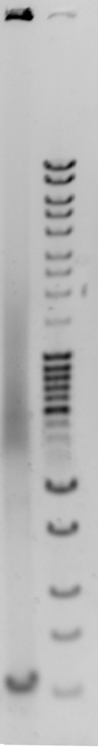
2013_09_03 remove pHps2 from pJ66 (pHps2 RFP pCM66T)
Results show no amplification. Used a different thermocycler (white eppendorf first, then black thermocycler 2nd) so try again in white thermocycler when I have time.

Slide 5
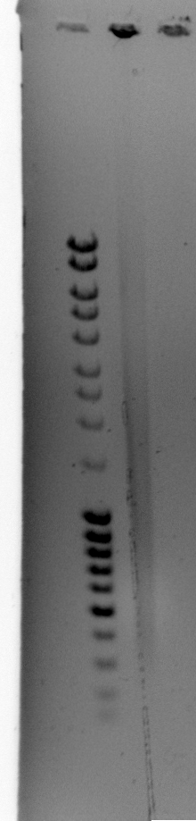
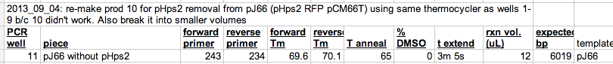
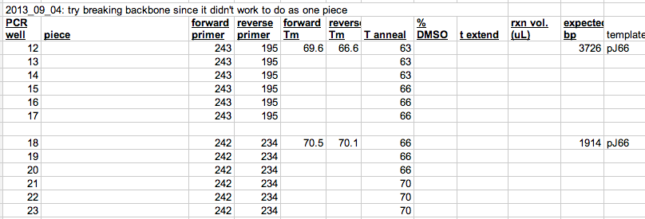
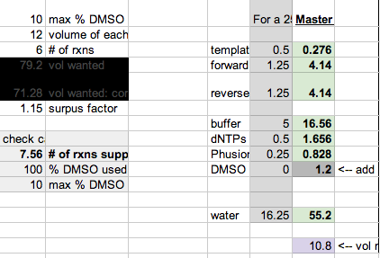
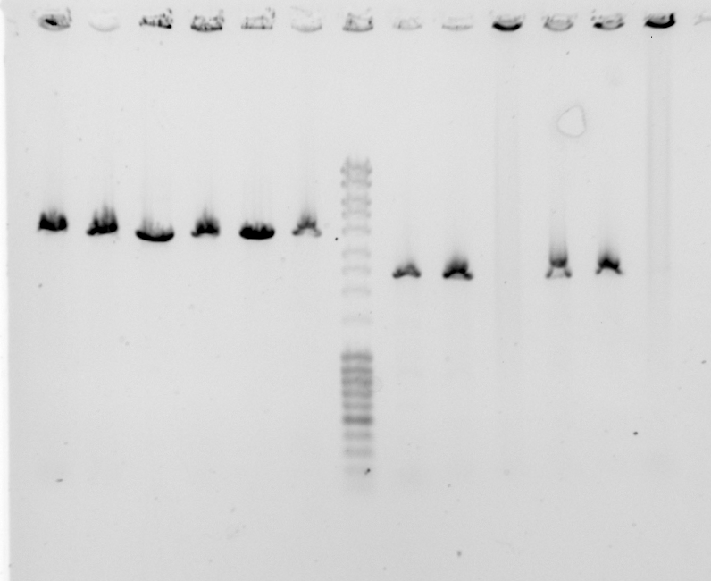
2013_09_03 remove pHps2 from pJ66 (pHps2 RFP pCM66T)

Slide 6
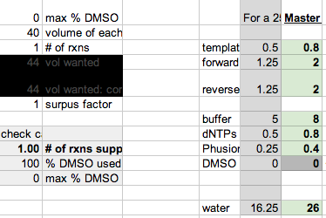
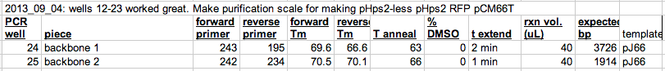
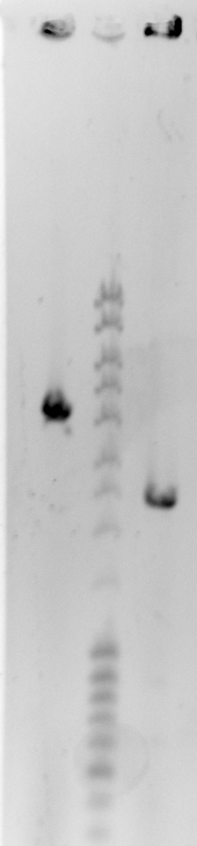
2013_09_03 remove pHps2 from pJ66 (pHps2 RFP pCM66T)
Dpn1 treat before cleanup later

Slide 7
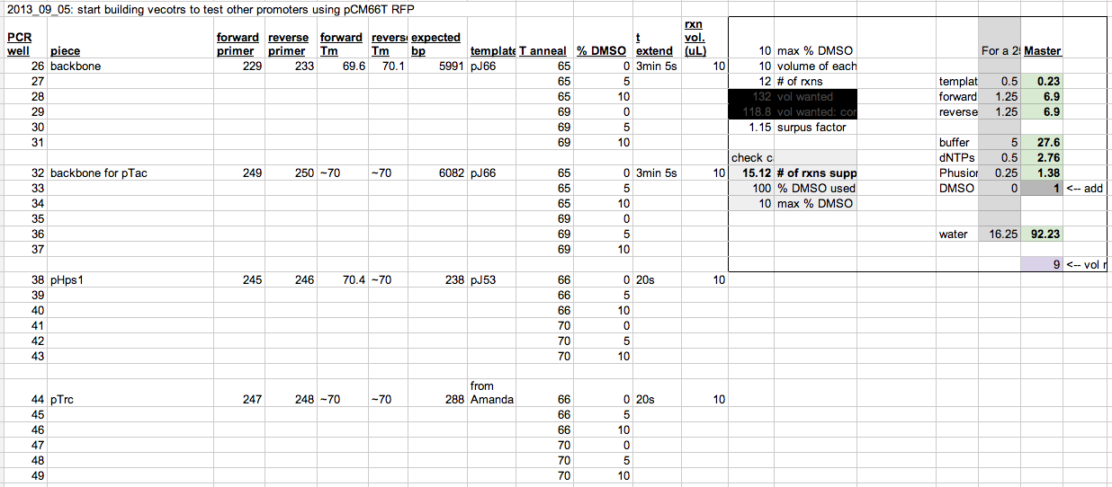
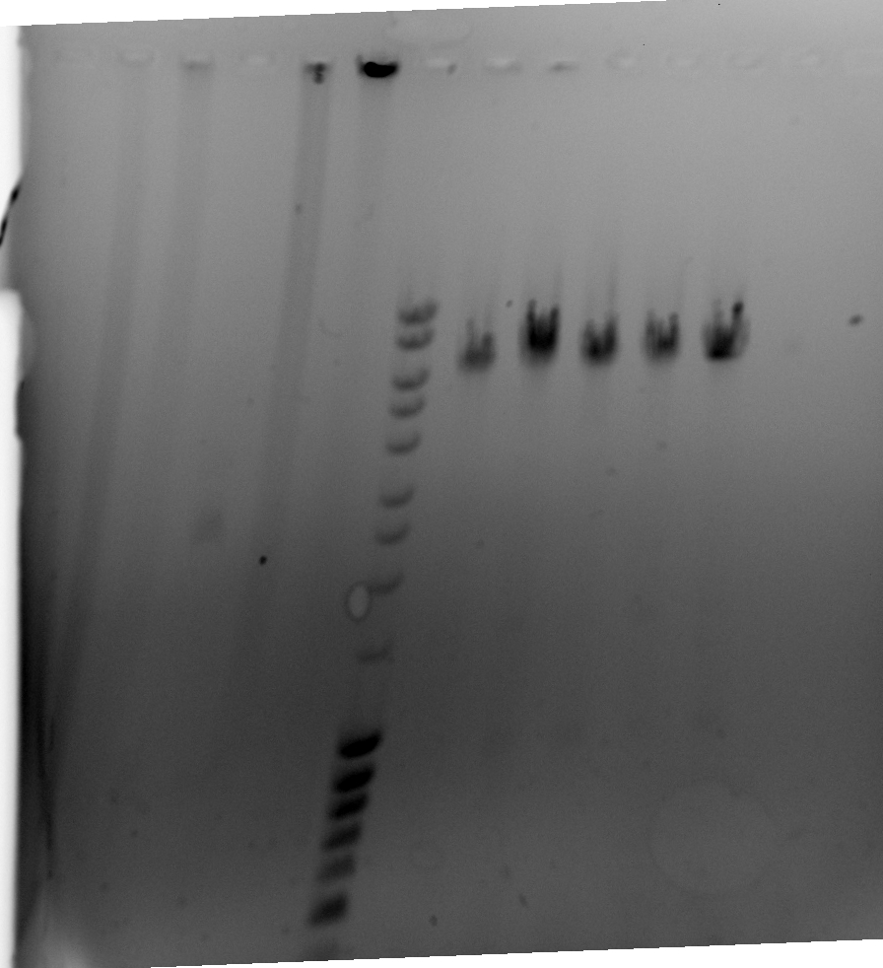
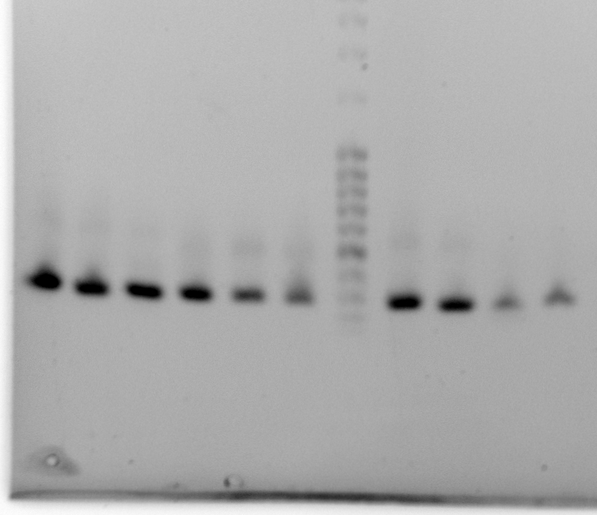
2013_09_05 prepare for pTrc, pTac, pHps1
Wells 26-37. Should have used primer 234, not 233 for 26-31
Wells 38-40, 44-46, 41-43, 47-49 all good but do purification scale of wells 38 and 44

Slide 8
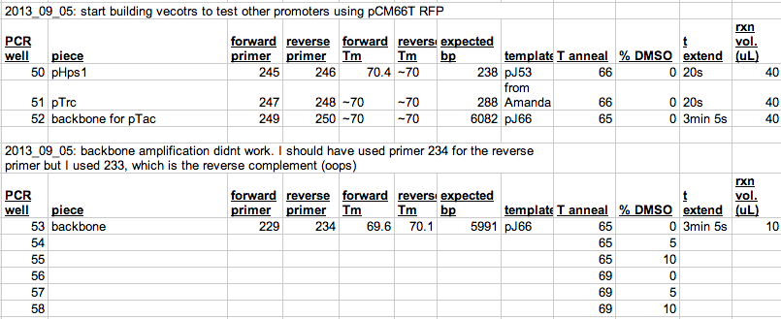
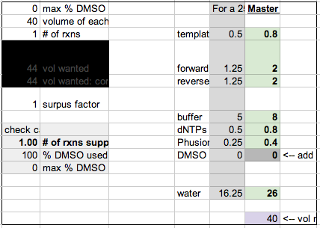
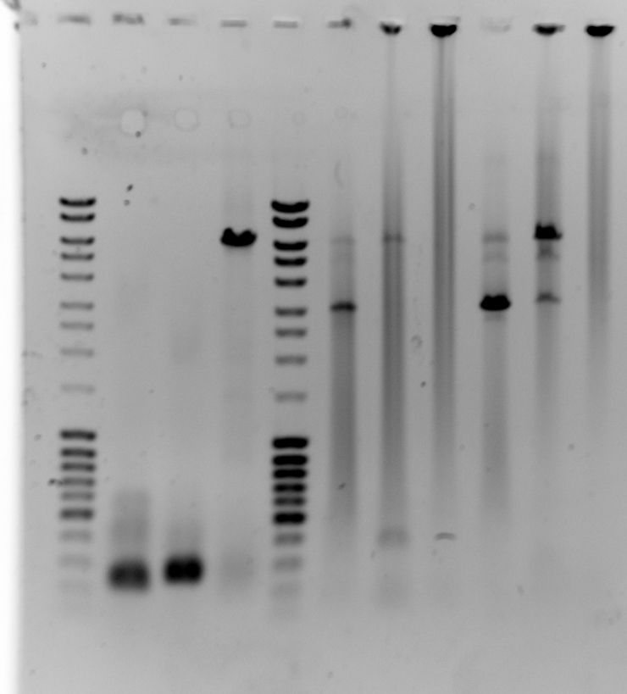
2013_09_05 prepare for pTrc, pTac, pHps1
Wells 50-52 look good. Add Dpn1 and put at 37oC until purification scale version of 53-58 is ready.
Make 120 uL of backbone w/ 0% DMSO and 69oC annealing.
Oops… should have done 5% DMSO at 69oC for purification scale but I did 0% in well 60. Doing well 61 correctly.

Slide 9
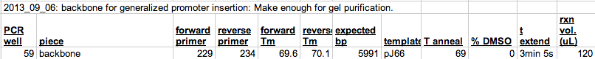
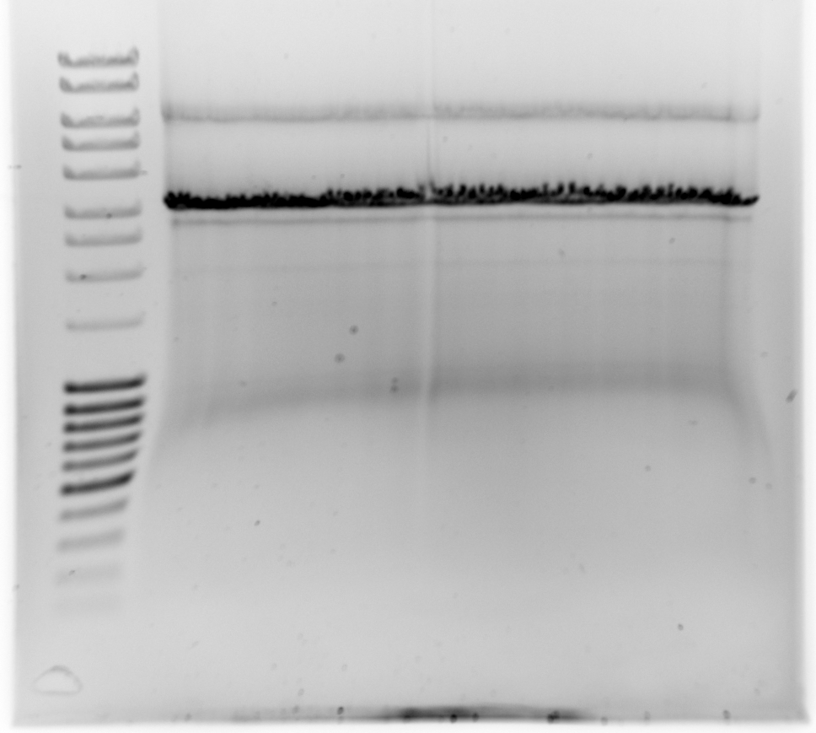
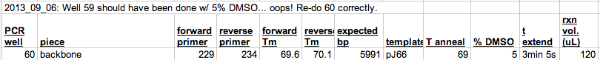
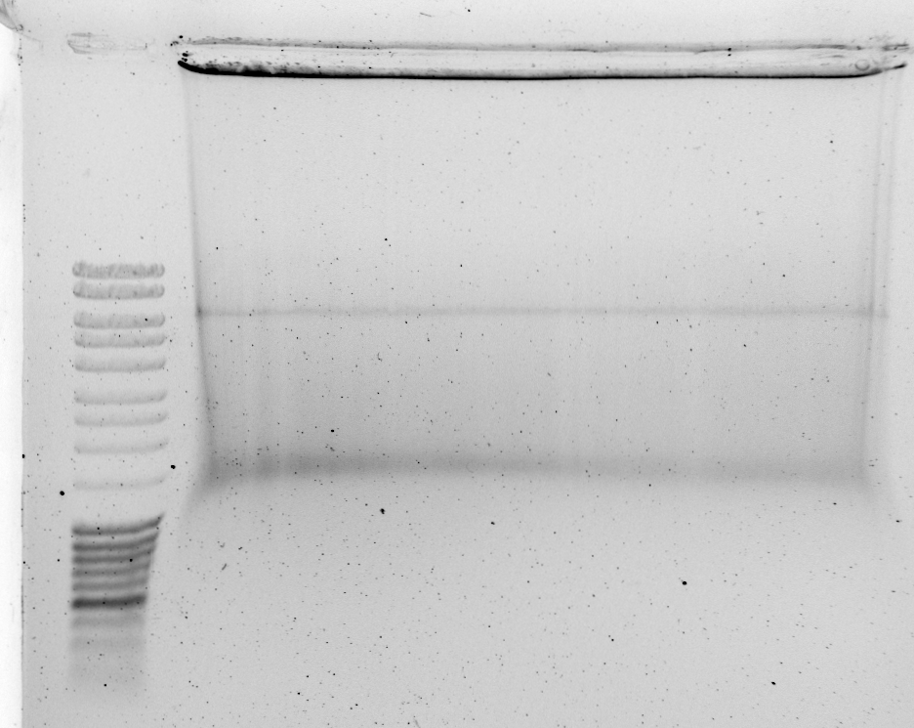
2013_09_05 prepare for pTrc, pTac, pHps1
Desired product
Added 0.5 uL Dpn1, incubate 3 hrs at 37oC

Slide 10
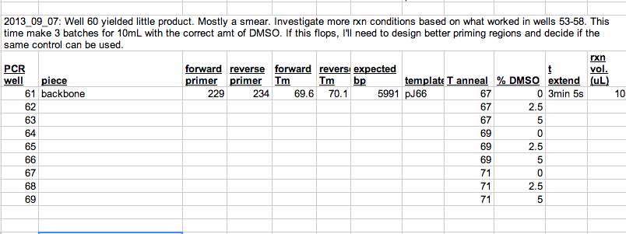
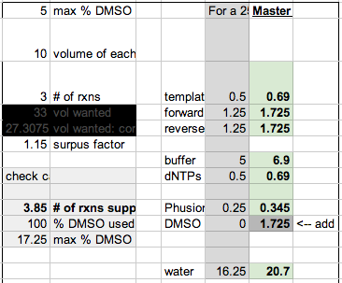
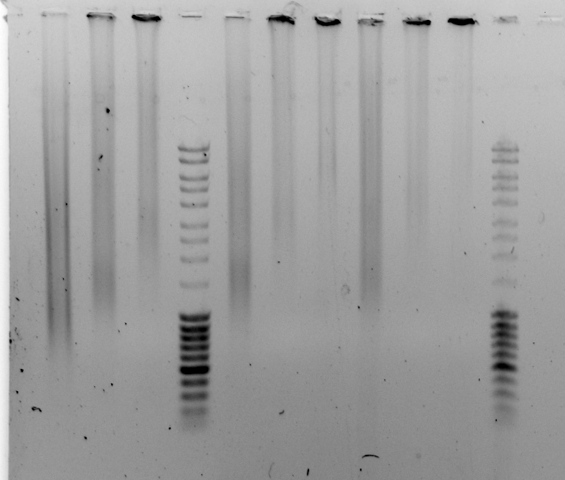
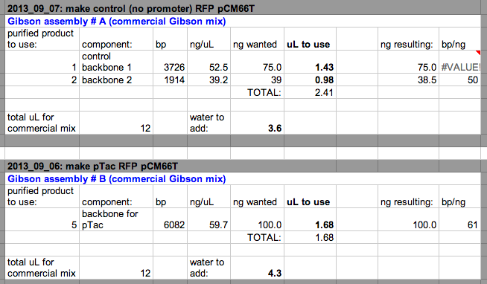
2013_09_05 prepare for pTrc, pTac, pHps1
Try harder to find a good backbone for the generic backbone piece used to put in promoter regions… well 60 looked bad.
Wells 61-69 didn’t work.

Slide 11
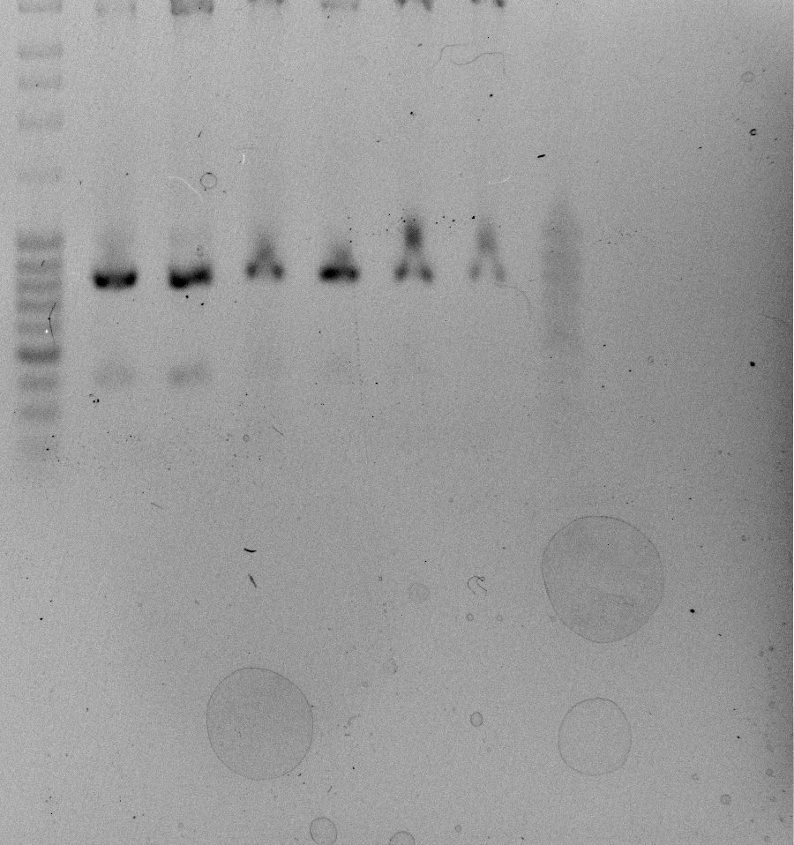
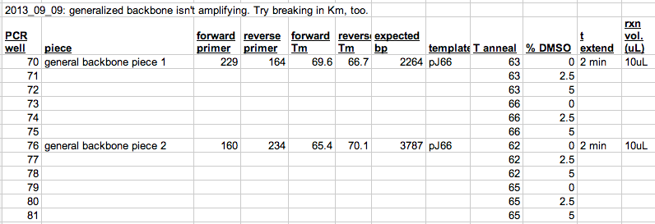
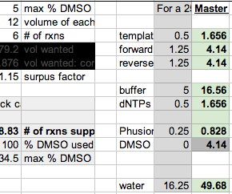
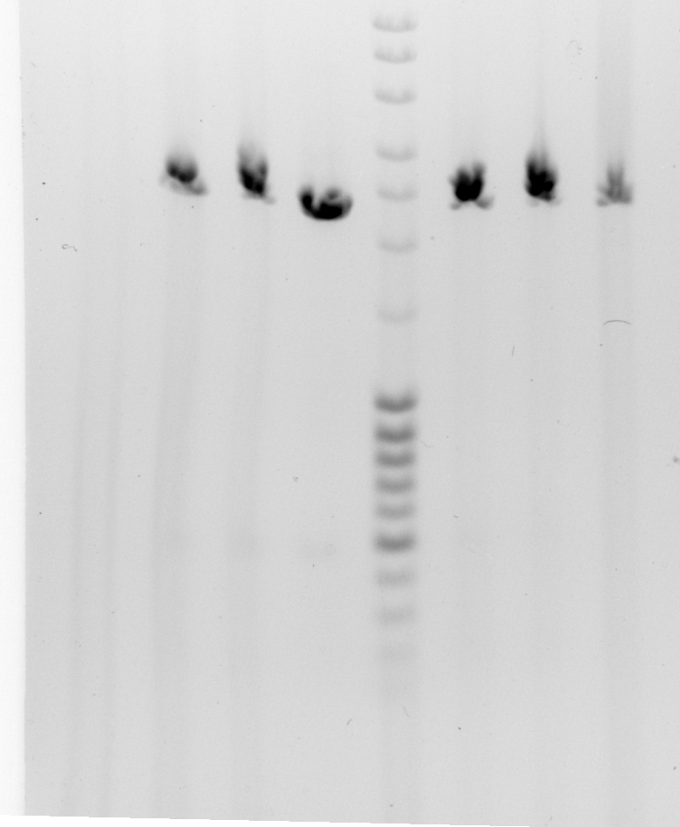
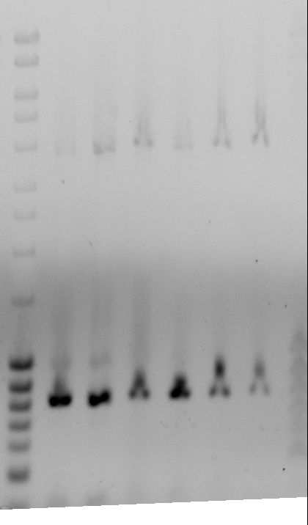
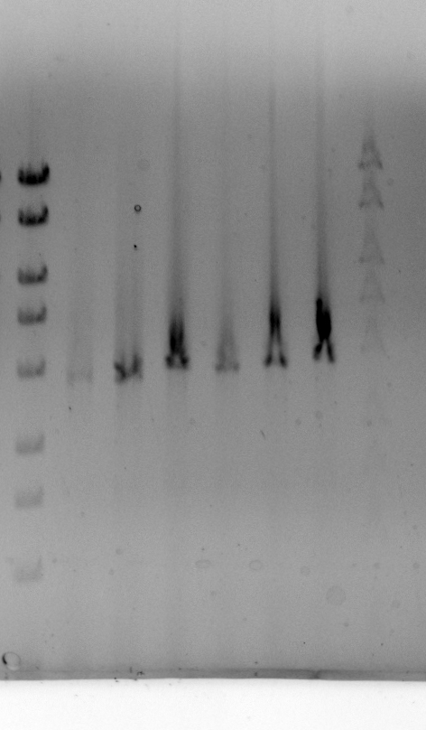
2013_09_05 make generalized backbone
Wells 76-81 are too small.
Expect 3787, got 800 bp. Product is ~ 2990 bp too small.
Were the previous failed amplifications too short by the same amount?
Look ~2000 bp too short but this is within error…
There aren’t any suspicious BLAST hits anywhere in the plasmid
Wells 76-81: left gel is before dye penetrated. Right is after bottom bands ran off.
Make purification scale of #81
Wells 70-75 look good

Slide 12
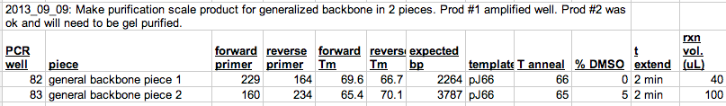
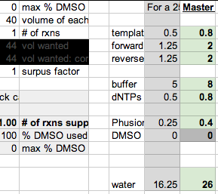
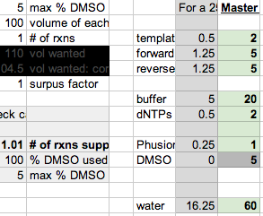
2013_09_05 make generalized backbone

Slide 13
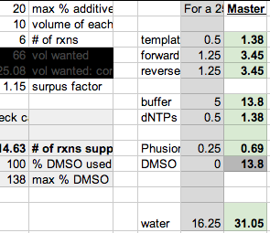
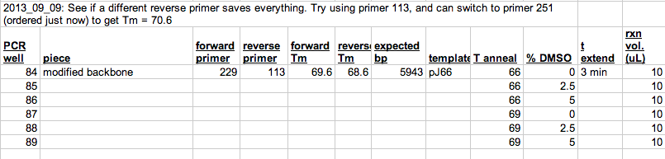
2013_09_05 make generalized backbone

Slide 14
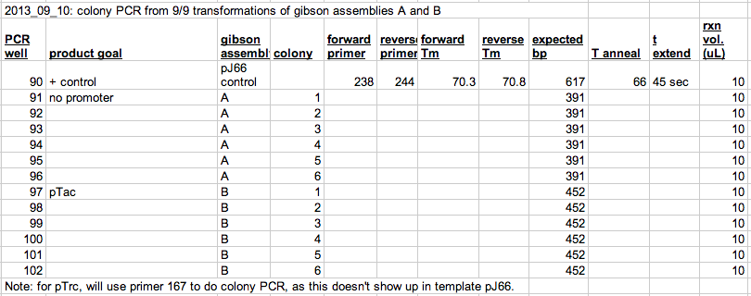
2013_09_05 Colony PCR control and pTac version

Slide 15
2013_09_03 remove pHps2 from pJ66 (pHps2 RFP pCM66T)

Slide 16
2013_09_03 remove pHps2 from pJ66 (pHps2 RFP pCM66T)

